Slide 1
Contracts and Grants Accounting
Award Closeout Procedures Effective July 1, 2014
C&G Training Presentation
Notes:
Objectives for this training:
Review what has changed, and what has not changed, in the closeout procedures
Cover how managers can implement best practices to ensure requirements/deadlines are met
Provide managers with the information, tools needed to train their staff
Detail processes that managers may need to review with staff to ensure consistent practice across campus AND compliance with sponsor and university requirements

Slide 2
Establishing Best Practices for Award Closeout
Closeout requirements and deadlines are set by the sponsors’ terms and conditions and federal guidelines
Only expenses recorded in the GL (either actual or accrued) can be included on the Final Invoice/Final Financial Report (FFR). Closeout procedures now drive toward achieving this requirement
Establishing and adhering to Best Practices will eliminate need for work-arounds and most exceptions
The “new” procedures are not really new. CGA is simply redefining and re-enforcing policies and procedures to improve compliance with Uniform Guidance.
Notes:
The only really ‘new’ procedures are adding more advanced noticing before expiration date, requiring accruals for expenses not yet posted, recording and reporting cost share, and deficit clearing of all overages to department fund.

Slide 3
Closeout Timeline
(dates in green are example only)
Final Award Activities
Award Closeout Process
May 2, 2014
June 1, 2014
July 1, 2014
July 31, 2014
October 10, 2014
October 29, 2014
November 27, 2014
90 Days - Termination Notice
60 Days - Termination Notice
30 Days - Termination Notice
Award Expired - Day Zero
CCF Form Due the next day after GL Close for 2nd Month after Award Expiration
90 Days - Award Closed & Final Financial Report is submitted
~ 120 Days – Deficit Clearing
30 Days
30 Days
30 Days
~20 Days
30 Days
Pre-Expiration Period
Adjustment Period
Final Closeout Period
Notes:
Tasks to be completed in each closeout phase, as well as the completion deadlines, have not changed. The standard 90-day time period for closing awards remains the same. The Award Closeout Certification form (replaces the Concurrence Report) is submitted the day after the GL is closed for the award’s closing month, the award close/Final Financial Report still due date is still +90 days.

Slide 4
Pre-Expiration Period
(dates in green are example only)
Final Award Activities
Award Closeout Process
May 2, 2014
June 1, 2014
July 1, 2014
July 31, 2014
October 10, 2014
October 29, 2014
November 27, 2014
90 Days - Termination Notice
60 Days - Termination Notice
30 Days - Termination Notice
Award Expired - Day Zero
CCF Form Due the next day after GL Close for 2nd Month after Award Expiration
90 Days - Award Closed & Final Financial Report is Submitted
~ 120 Days – Deficit Clearing
30 Days
30 Days
30 Days
~20 Days
30 Days
Pre-Expiration Period
Focus final award management activity on concluding financial transactions before the expiration date. CGA will send 3 Notices prior to Termination date to support this. CSS-RA and department should review award transactions, correct/transfer expenses including payroll, request final invoice from subcontractors, and notify recharge units and departments with allocated funds to update ChartStrings.
Notes:
CSS-RA/Department should not wait for CGA notices to meet with PI and begin planning/closing out an award. Shift the ‘closeout’ focus to finalizing award financial activity BEFORE the expiration date (rather than during the Adjustment Period).

Slide 5
Pre-Expiration Period
objective: Finalize all award financial transactions to get expenses posted to the GL
CGA will send Termination Notice at 90, 60, and 30 days before award expiration date
PI and RA get 3 notices for each award
CAOs and Managers will receive 3 notices that compile all awards that expire within the same month
Request no-cost extension from SPO no later than 60 days prior to award expiration date
PI and RA should discuss the potential need for an extension well in advance of the award termination date
Sponsor may have other restrictions, deadlines that take precedence

Slide 6
Pre-Expiration Period
Task | Updated deadline/procedure that affects task
Request no-cost extension if required | Request extension no later than 60 days prior to expiration date
Review transactions to ensure they are complete, accurate and allowable. Initiate/request cost transfers and payroll transfers as needed. Discontinue expenditures from recharge centers. Change payroll ChartString for future payroll distributions.
Request final invoice from Subcontractors | Final invoice must be received within 45 days after the expiration of award
Initiate all required payroll adjustments | Make payroll adjustments in the PPS system via UPAY, not through a cost transfer journal entry
Notes:
All of the tasks that should be initiated/completed before the award expires remain the same.
CGA will provide more advance notice to assist CSS-RA/Dept with completing award financial activities well in advance of award termination date. Deadlines will be universally reinforced to ensure these tasks are accomplished in the correct timeframe.

Slide 7
Adjustment Period*
(dates in green are example only)
Final Award Activities
Award Closeout Process
May 2, 2014
June 1, 2014
July 1, 2014
July 31, 2014
October 10, 2014
October 29, 2014
November 27, 2014
30 Days - Termination Notice
Award Expired - Day Zero
CCF Form Due the next day after GL Close for 2nd Month after Award Expiration
90 Days - Award Closed & Final Financial Report is Submitted
~ 120 Days – Deficit Clearing
90 Days - Termination Notice
60 Days - Termination Notice
30 Days
30 Days
30 Days
~20 Days
30 Days
Adjustment Period
During the adjustment period, closeout activity should center around ensuring all expenses are accurately represented in the GL. ONLY transactions in the GL will be included on the Final Invoice/FFR. Once the Award Closeout Certification form has been submitted, all accruals or new costs charged to award fund should cease.
*NOTE: If award specifies less than a 90-day closeout, the subcontractor final invoice deadline, and the Closeout Certification form and Cost Sharing Contribution Report deadline will be determined by sponsor and CGA requirements.
Notes:
Use the Adjustment Period to verify expenses and accrue for expenses not yet posted so that everything is recorded in the GL and is accurate and allowable (this is not the time to finalize invoices or costs – that should already be done).

Slide 8
Adjustment Period
objective: Verify expenses and accruals posted to the GL are complete and accurate. Submit Award Closeout Certification form, Cost Sharing Contribution Report.
During the Adjustment Period:
Process payroll transfers via UPAY by the cut-off date of the second GL cycle following the award expiration
Process all non-payroll transfers and transfer overdrafts by the cut-off date of the second GL cycle following the award expiration
Accrue for unposted expenses by the cut-off date for the second GL cycle after the award expiration (auto-reversing accrual)
Journal transfers temporarily allowed to record payroll cost transfers in GL
Due no later than the day after the GL is closed for the Award’s closing month:
Submit supervisor-approved Closeout Certification Form -- which verifies all expenses/accruals have been recorded in the Actuals Ledger – by GL close of the 2nd month after the award’s expiration date
Submit supporting GL and Cost Sharing Contribution Report (if applicable)
Notes:
If award financial activity has been initiated/completed BEFORE the expiration date (i.e., if Best Practice is followed), the Adjustment Period deadlines should be achievable.
Actual number of days for adjustment activities varies slightly. Make all adjustments by the cut-off date for the second GL cycle after the award expiration date. The Award Closeout Certification form is due the day after the GL is closed the day after the GL is closed for the award’s closing month.

Slide 9
Adjustment Period
Task | Deadlines that affect task
Verify accuracy of all expenses in GL, transfer unallowable charges, overdrafts | Transfer any erroneous charges and overdrafts within 2 months of award expiration date*
Accrue expenses not yet posted to the GL: accrue for estimated amount (if known) or greater | Post accruals at the beginning of 3rd month after the award’s expiration date, but before cut-off date of 2nd GL cycle after expiration*
Verify final invoice from Subcontractors | Subcontractors now required to submit final invoice within 45 days so that it can be processed, posted to GL in time
Verify payroll adjustments requested via UPAY are made in PPS and reflected in the GL | If payroll transfers requested via UPAY are not in the GL, posting a payroll transfer via journal transfer is temporarily allowed*
Verify all Cost Sharing commitments are met, coded correctly in GL. Submit Cost Sharing Report to CGA | Report due to CGA as an attachment to the Closeout Certification Form
Submit Award Closeout Certification Form for approval by preparer’s Supervisor, then on to CGA | Form and all supporting documentation due to CGA the second day after the GL close of the 2nd month after the award’s expiration date
Notes:
Actual number of days for adjustment activities varies slightly because it is based on the accounting month close date. Expiration date ~70 days (day after the GL is closed for the award’s closing month) is the last date for approved Closeout Certification form submission. ONLY CHARGES RECODED IN THE GL CAN BE INVOICED.
Use the award spending plan, PO, subaward contract, etc. to estimate the dollar amount to accrue for expenses not yet received/invoiced.

Slide 10
Accruals Defined
Definition: An expense accrual is the recording of the cost estimate for a product or service that was delivered during the award period but not yet been recorded in the General Ledger. Most non-payroll expenses that, in the past, were included on the Closeout Instructions for an Award (aka Concurrence Report) as “adjustments” fit this definition. Post auto-reversing accruals only for direct expenses.
Examples:
Subaward services performed where the invoice has not yet been received/processed
Recharges which haven’t shown up as expenses in the Actuals Ledger
Travel which occurred within the award period but the expense hasn’t yet been recorded in the Actuals Ledger for the award
Accruals are not USED FOR:
Estimated expenses for goods or services which were not incurred before the award expiration date
Cost transfers and payroll transfers*

Slide 11
Accrual Timing Example for Award with Expiration Date of July 31, 2014
10/1/14 – 10/7/14
Check GL to determine if accrual is needed
No Later than 10/7/14
Accrue expense before cut-off date of 2nd GL cycle following award expiration
11/1/14 – 11/7/14
Check to see if actual expense was recorded
No Later than 11/7/14
If actual expense is not recorded or is incomplete, record a subsequent accrual
Date accrual entry 9/30/14 with an automated reversal on 10/1/14
Date subsequent accrual entry 10/31/14 with an automated reversal on 11/1/14
If actual expense is greater than accrual, clear deficit
10/10/14, 10/29/14
Submit Closeout Certification form to CGA by next business day
Final Financial Report/Invoice sent by CGA to sponsor on 10/29/14
If actual expense is less than accrual, contact CGA
Notes:
TO GET ACCRUALS INTO GL IN TIME:
The last day for new accounts payable expenses hitting the September 2014 ledger is 9/30/14 (the last calendar day of the month)
Payroll and the related CBR for September will post by the 4th business day of October (10/6/14)
The last day for recharge batches hitting the September 2014 ledger is 10/7/14
The last day for accruals for awards ending 7/31/14 is 10/7/14
CHECK THAT ACTUALS MATCH ACCRUALS -- between 11/01/14 and 11/07/14:
verify that the actual amount posted is complete and the accrued amount matches (if match, no further actions needed)
If accrual was less than actual, then deficit should be cleared by the RA/department or the Deficit Clearing program will clear it to a default chart string
If the accrual was greater than the actual, determine if another accrual is needed (i.e., the reported actual is not final/complete) or if CGA should refund the excess revenue
If actual expense has NOT posted, contact CGA to request subsequent accrual

Slide 12
Transferring Payroll Costs
Transfer of payroll expenses will be temporarily allowed via an auto-reversing GL journal entry made during the award’s Adjustment Period.
This “work around” manages the lag between submitting a UPAY request and seeing the subsequent payroll costs posted in the Ledger.
RAs and Fund Managers should still process/request a payroll transfer via UPAY to properly document the transfer
If a reversing journal transfer is used to post payroll for timely closeout, note this on the Closeout Certification Form, and attach the original UPAY request
Notes:
Although it is inappropriate to process payroll cost transfers directly in the Actuals Ledger rather than through the payroll system, a temporary exception has been made to ensure these payroll costs are reflected in the GL in time to close out an award.

Slide 13
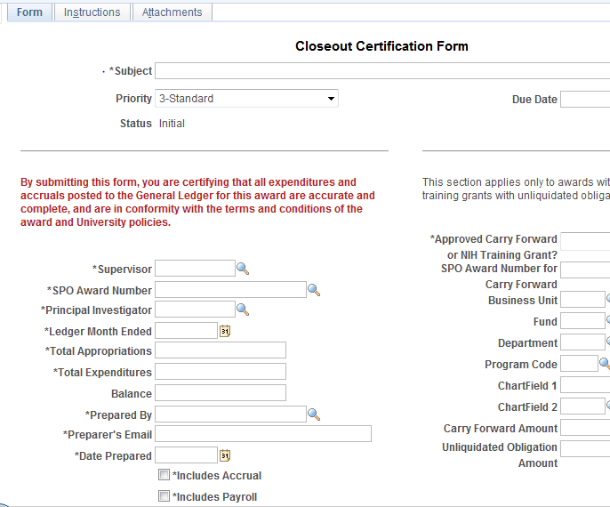
Closeout Certification Process
The Closeout Certification Form is online (BFS RA Grants WorkCenter)
Replaces Concurrence Report (aka Instructions for Award Closeout)
GL with expenses and accruals, and all other supporting documents (Cost Sharing Contribution) attach to form
Carry forward noted on form
Workflow routes form to Supervisor for approval before submitting to CGA
Form due to CGA the day after the GL is closed for the award’s closing month
Notes:
In the past, outstanding expenses were listed on the Concurrence Report. Now anticipated costs are posted to the GL as accruals (not written on the form) and noted on the form -- just check the box!

Slide 14
Final Closeout Period
(dates in green are example only)
Final Award Activities
Award Closeout Process
May 2, 2014
June 1, 2014
July 1, 2014
July 31, 2014
October 10, 2014
October 29, 2014
November 27, 2014
90 Days - Termination Notice
60 Days - Termination Notice
30 Days - Termination Notice
Award Expired - Day Zero
CCF Form Due the next day after GL Close for 2nd Month after Award Expiration
90 Days - Award Closed & Final Financial Report is Submitted
~ 120 Days – Deficit Clearing
30 Days
30 Days
30 Days
~20 Days
30 Days
Final Closeout Period
CGA prepares the FFR/ Final Invoice and Cost Share Report for the sponsor (using the GL and reported cost sharing) and prepares FSCG50 Report for the department. Once the FFR is submitted, CGA clears any deficit and closes the award in BFS.
Department closes POs before CGA clears deficit. NOTE: once Deficit Clearing runs, BFS project status controls will not allow any new PO, AP and GL transactions to post to the award chart string.
Notes:
Once the RA/Department has submitted the Closeout Certification form, CGA has approx. 20 days for final verification of all reported costs (including cost sharing) and to prepare the Final Financial Report (FFR) and Cost Sharing Report for the sponsor. The FFR is due to the sponsor 90 days after the award expiration date (the FFR due date is commonly referred to as “award close”).
The Department should close all POs no later than the award close date (expiration+90 days).
After award close, CGA has 30 days to resolve any overspending deficits, close the award in BFS, and prepare the FSCG50 Report for the Department.

Slide 15
Final Closeout
objective: Complete, accurate Final Financial Report/Invoice and Cost Sharing Report sent to sponsor by award close date (expiration + 90 days). Award ChartString cleared of all balances, closed to further spending.
CGA prepares FFR based ONLY on expenses recorded in the GL
All spending over the authorized amount will be included in Deficit Clearing
CGA verifies Cost Sharing Contribution Report, prepares and submits final report to sponsor
CSS-RAs/Departments to close all award POs before the award close date and FFR/Final Invoice submitted (expiration + 90 days). This will ensure:
No one can inadvertently voucher against the award PO
No open contractual obligations exist on closed awards
CSS-RAs/Departments checks that actual expenses post, match accrued amount
If actuals have not posted, re-accrue using another auto-reversing accrual transaction
If any spending over the authorized award amount exists at the award close date, that overspending balance will be deficit cleared and allocated to the Department's unrestricted fund.

Slide 16
Final Closeout
Task | Deadline
CGA prepares Final Financial Report/Invoice using the GL and Closeout Certification form, submits to sponsor | Award close date (90 days after award expiration)
CGA prepares Cost Share Report (if required) using GL and Cost Sharing Contribution Report from CSS-RA/Dept, sends to Sponsor. | Award close date (90 days after award expiration)
CSS-RA/Department closes POs | Award close date (90 days after award expiration)
CSS-RA/Department confirms actual costs have posted, match accrued amount. Re-accrue with auto-reverse if actuals not posted/incomplete. | Cut-off date for 3rd month after award
CGA refunds sponsor if actual expense is less than accrual (if actual is greater than accrual, clear the deficit) | ~120 days after expiration date
CGA clears deficit spending above award amount by transferring all overdrafts to departmental unrestricted fund, then deactivates the award in BFS | ~120 days after expiration date
*Departments have up until the 5th business day of the month following the recording of the actual expense to clear any deficits.
Notes:
RAs/Department Administrators should watch the award balances up until the deficit clearing process runs – typically this will be around 120 days after the award expiration date.

Slide 17
PO Closeout Procedures
Closing a PO means ensuring that any PO lines that use an expired award’s chart string has a zero balance. While the action of closing the PO is typically handled by the RA’s purchasing group, the RA is responsible for ensuring that this occurs.
Situation | Action
A single-line PO has: A non-zero balance Uses an expired award’s chart string | Reduce the PO amount equal to the expended amount leaving a balance on the PO equal to zero
A multiple-line PO may have: Line 1 A non-zero balance Uses an expired award’s chart string Line 2 A non-zero balance Uses an unrestricted fund’s chart string | Reduce the PO amount by reducing the balance on Line 1 to zero Transfer the balance on Line 1 to Line 2
The award will remain in a BFS status that allows transactions to process until all PO on the award are closed.
Notes:
RA Responsibilities Include:
Checking to make sure the product or service has been delivered
Verifying that the invoice has been received and matched against the PO
Validating that if a remaining balance exists, it is not related to outstanding invoices for products or services delivered within the award period
Contacting their purchasing group to ask them to remove the lien
Verifying that the lien removal occurred

Slide 18
Summary of Close Out
~90 day Pre-expiration period
Request final invoices, make transfers
Award Expiration Date
Adjustment Period
Transfer expenses and overdrafts
Award expiration Date + 2 GL Closing Months
~20 days
Award expiration date + 90 days
~30 days
Transfer payroll via UPAY
Create accruals (payroll transfers)
Request recharge changes, cessation
Request no-cost extension if required
CGA verifies final costs for Final Financial Report/invoice
RA/Dept transfers overdrafts, closes POs
Deficit clearing runs
Award close: Final Financial Report due to sponsor
RA/Dept checks that actuals match accruals, takes action if required
Change payroll chartstring for future distributions
Award spending stops
Award Closeout Certification form due by the next day after GL close of the 2nd month after the award’s expiration date

Slide 19
Summary of Close Out Changes (effective July 1, 2014)
CGA will send Termination Notice at 90, 60, and 30 days
Request no-cost extension no later than 60 days prior to award expiration date
Only expenses posted to GL can be invoiced and included on Closeout Certification form, Cost Sharing Contribution Report
Process cost transfers by the cut-off date of the second GL cycle following the award expiration date
Accrue non-payroll expenditures not in GL by the cut-off date of the second GL cycle following the award expiration
Process payroll transfers via UPAY by the cut-off date of the second GL cycle following the award expiration date
Provide Award Closeout Certification Form by the next day after GL close of the 2nd month after the award’s expiration date
Provide Cost Sharing Contribution Report as an attachment with the Closeout Certification Form (if applicable)
(continued)

Slide 20
Summary of Close Out Changes (effective July 1, 2014)
Subawardees/subcontractors submit final invoice within 45 days after Award Expiration date
Effective for subawards beginning or modified 3/20/14 and later
Payroll cost transfers through journal entries temporarily allowed
If payroll transfers properly requested are not reflected in the GL, process an auto-reversing journal transfer before the cut-off date for the second accounting period following the award expiration.
Close POs before FFR/ Final Invoice due date (award expiration + 90 days)
ALL overspending will be included in Deficit Clearing for the award, regardless of dollar amount
CGA will no longer cover the first $300 of a deficit

Slide 21
Contracts & Grants Implementation Project
http://controller.berkeley.edu/departments/ contracts-grants-accounting
contractsgrants@berkeley.edu

Slide 22
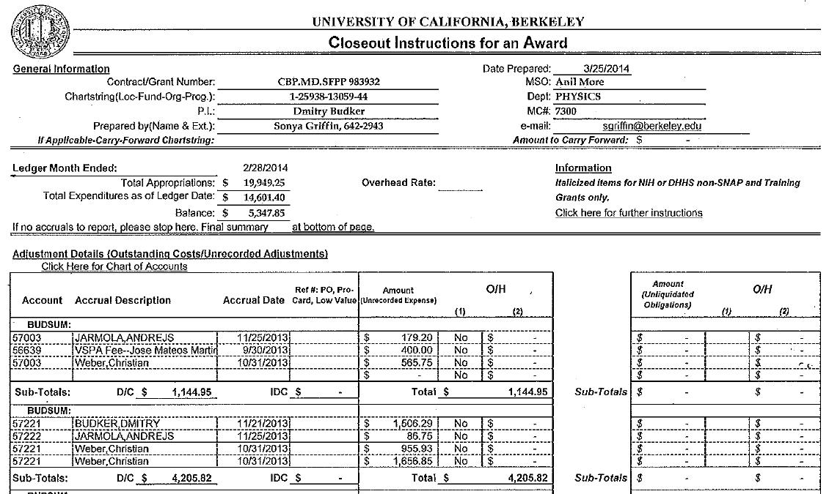
Accrual Example

Slide 23
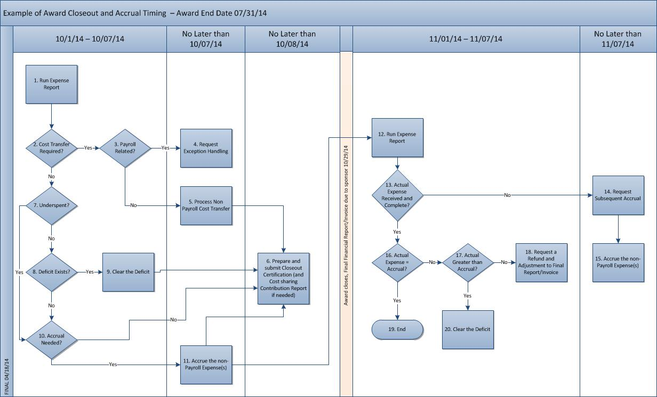
Closeout, Accrual Timing Example

Slide 24
When to Create Accruals
The RA/Department Administrator should review the expenses posted to the award between the 1st and 5th business day of the third month following the award expiration, to determine if there are outstanding expenses that should be accrued.
Create AUTO-REVERSING accruals by the cutoff date for the second GL cycle* following the award expiration date. This ensures the accruals are posted to the GL in time to be included in the FFR. Date accruals using the last day of the previous month.
At the beginning of the month following the award close date (expiration + 90 days), the RA/Department Administrator should check to see if the actual expense posted and matches the accrued amount. If the expense did not post or is incomplete, post a new auto-reversing accrual. If the expense is greater than the accrual by +$300, the RA should submit a Closeout Exception Request (to add the add’l expense to the invoice).
*NOTE: If award specifies less than a 90-day closeout, the Closeout Certification form and Cost Sharing Contribution Report deadline will be determined by sponsor and CGA requirements.

